Slide 1
Earthquake–Tsunami Data Analysis
A comprehensive analysis exploring seismic patterns, magnitude-depth relationships, and tsunami indicators to identify critical insights about earthquake behavior and tsunami potential.

Slide 2
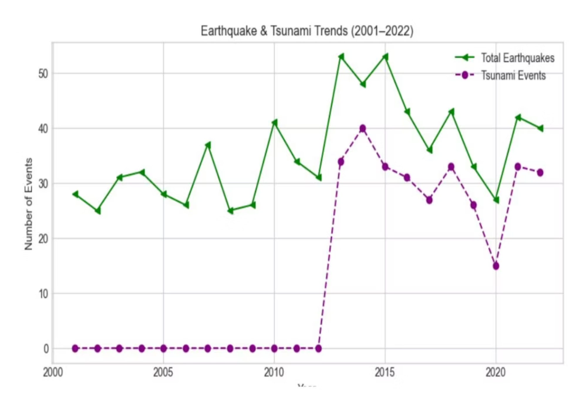
Geographic Distribution Patterns
Global Seismic Activity
Earthquake events plotted by latitude and longitude reveal distinct geographical patterns across tectonic boundaries.
Regional clustering indicates localized tectonic vulnerability, particularly in coastal and subduction zones.

Slide 3
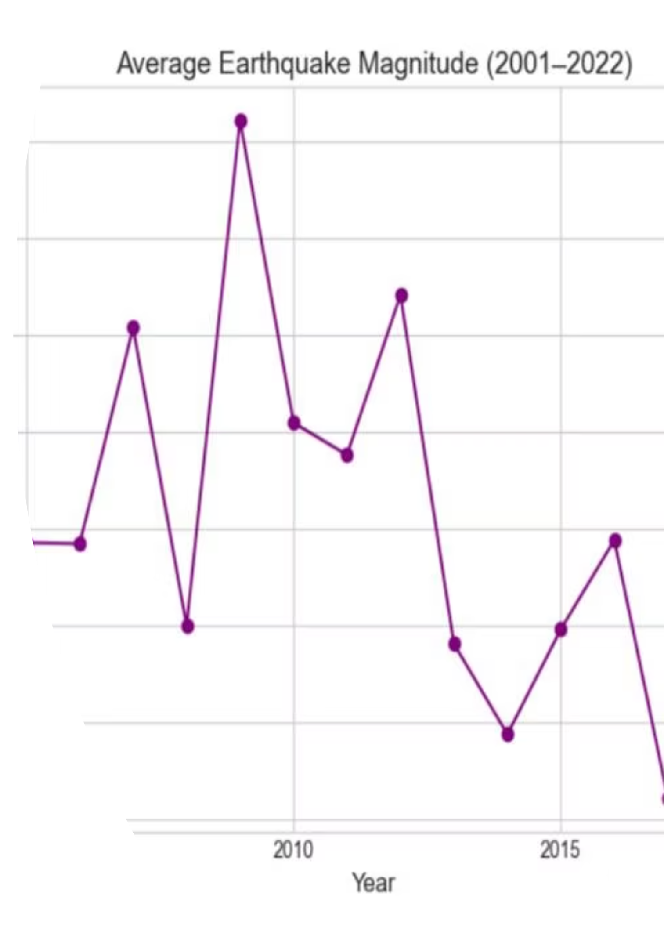
Tsunami vs Non-Tsunami Events
Visual Distinction
Color-coded scatter points clearly separate tsunami-triggering earthquakes from non-tsunami events.
Pattern Recognition
Spatial analysis reveals specific zones where tsunami generation is more likely to occur.

Slide 4
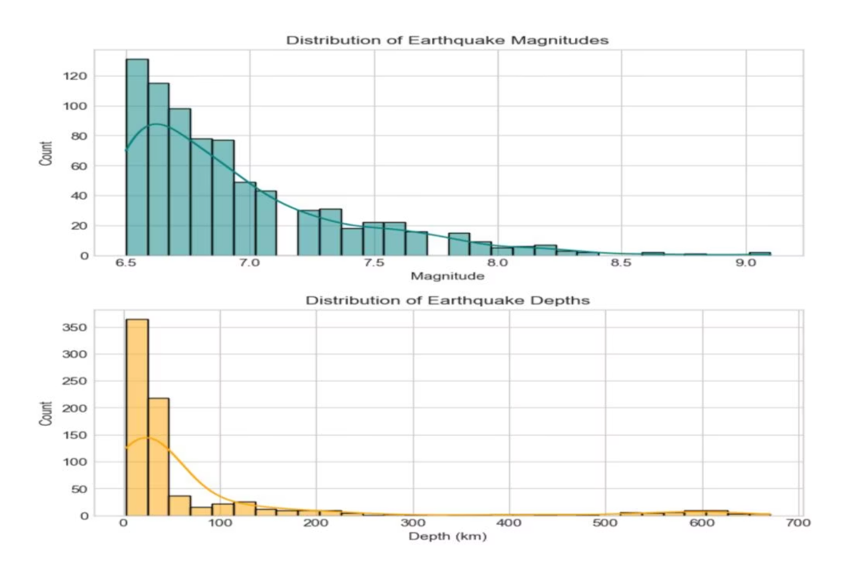
High-Density Tsunami Regions
Concentration Zones
Hexbin visualization identifies areas with the highest frequency of tsunami-triggered earthquakes.
These high-density regions correspond to major subduction zones and coastal tectonic boundaries worldwide.

Slide 5

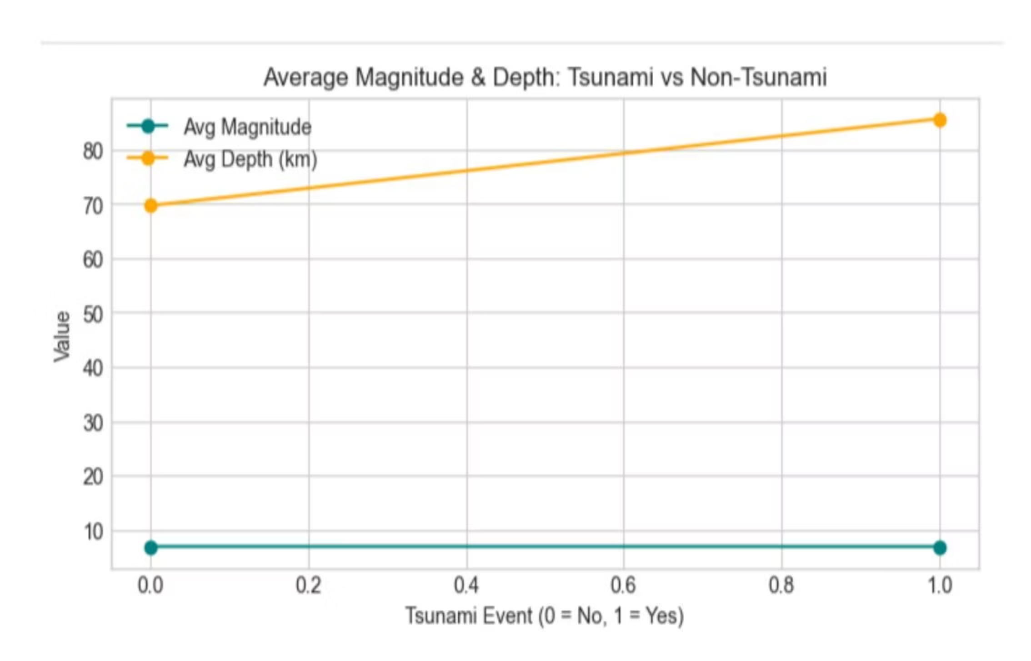
Magnitude and Depth Comparison
Magnitude Patterns
Depth Variations
Tsunami events show higher average magnitudes, typically above 7.5–8.0 threshold.
Shallower earthquakes demonstrate greater tsunami potential with increased variability in depth measurements.
Statistical Significance
Boxplot analysis reveals distinct distributions between tsunami and non-tsunami earthquake characteristics.

Slide 6
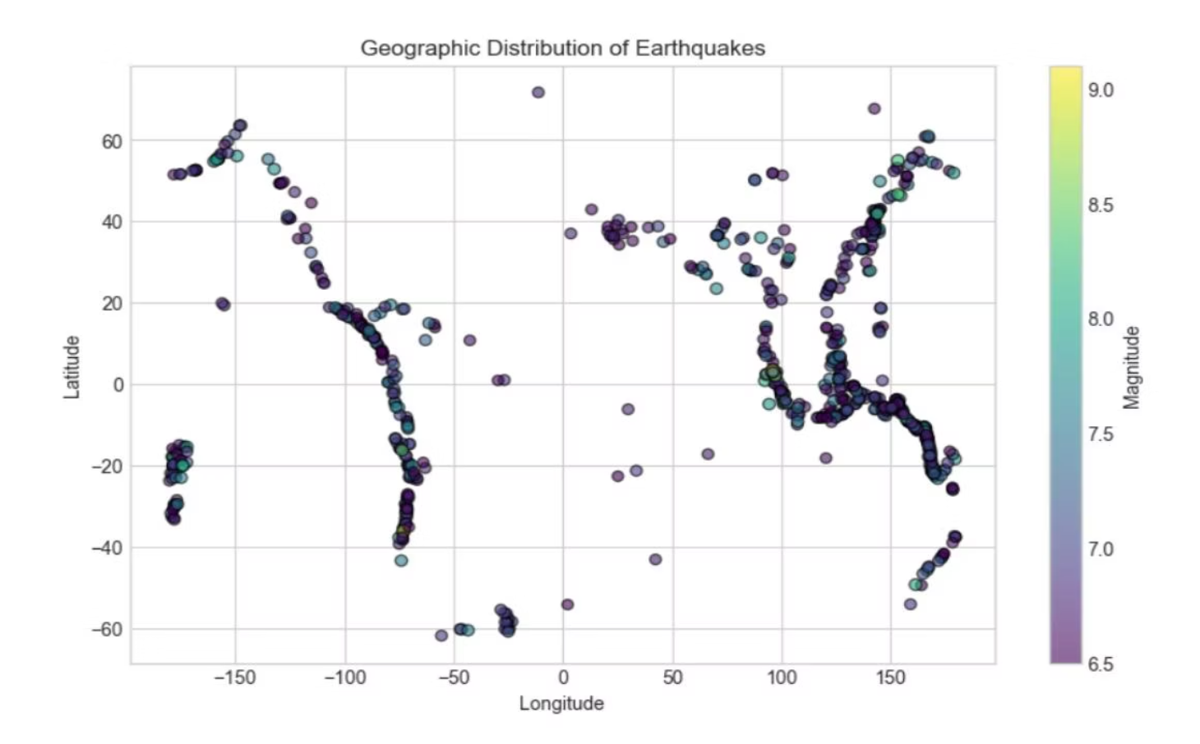
Magnitude Distribution Analysis
Frequency Patterns
Histogram reveals the distribution of earthquake magnitudes across both event types.
Higher magnitude events (7.5+) show increased correlation with tsunami generation, establishing a clear threshold for risk assessment.

Slide 7

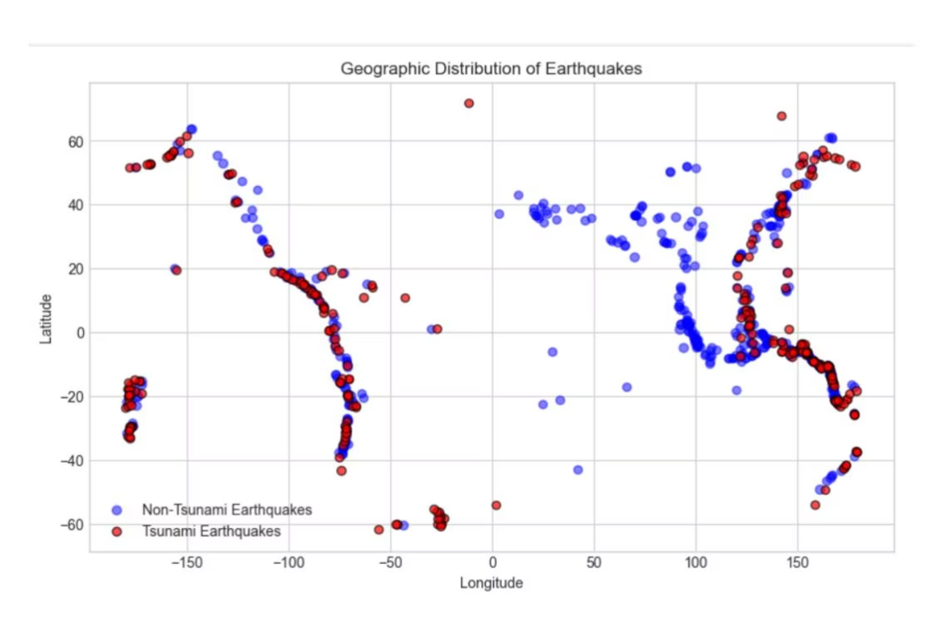
Event Occurrence Comparison
85%
15%
7.5+
Non-Tsunami Events
Tsunami Events
Critical Magnitude
Significant portion triggers tsunami activity
Majority of earthquakes do not generate tsunamis
Threshold for tsunami generation risk

Slide 8
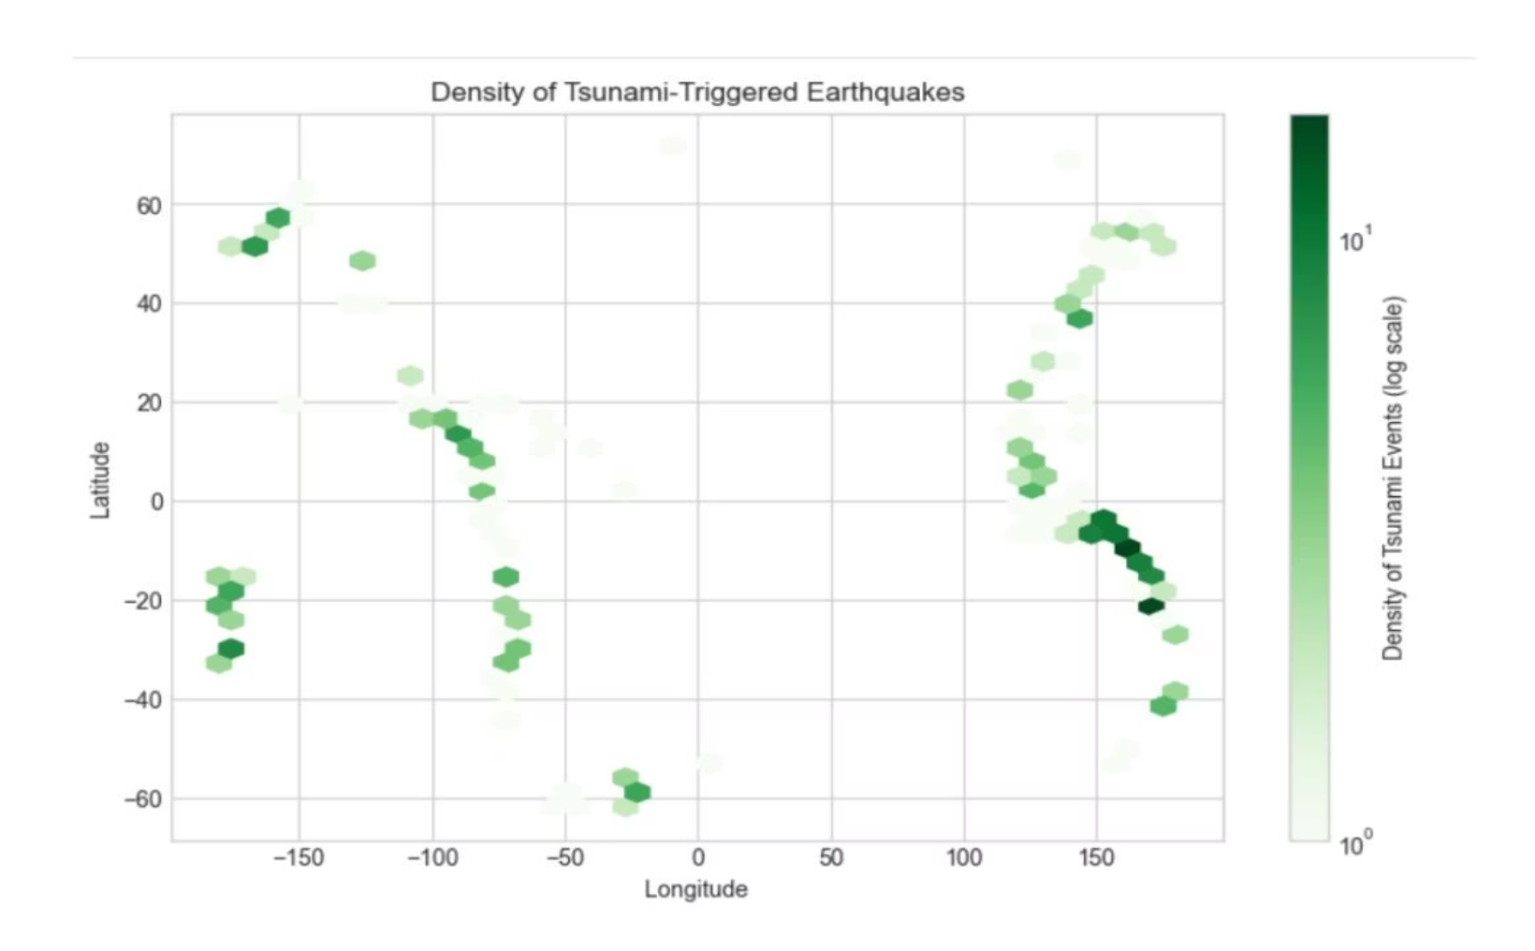
Correlation Analysis
Variable Relationships
Heatmap reveals strong positive association between magnitude and tsunami occurrence.
Depth shows inverse correlation—shallower earthquakes increase tsunami likelihood significantly.

Slide 9
Key Risk Indicators
01
02
Magnitude Threshold
Shallow Depth
Earthquakes above 7.5–8.0 show significantly higher tsunami potential
Reduced depth correlates with increased energy transfer to ocean water
03
04
Geographic Clustering
Depth Variability
Coastal and subduction zones demonstrate concentrated tsunami activity
Greater variation in depth measurements observed for tsunami-linked earthquakes

Slide 10




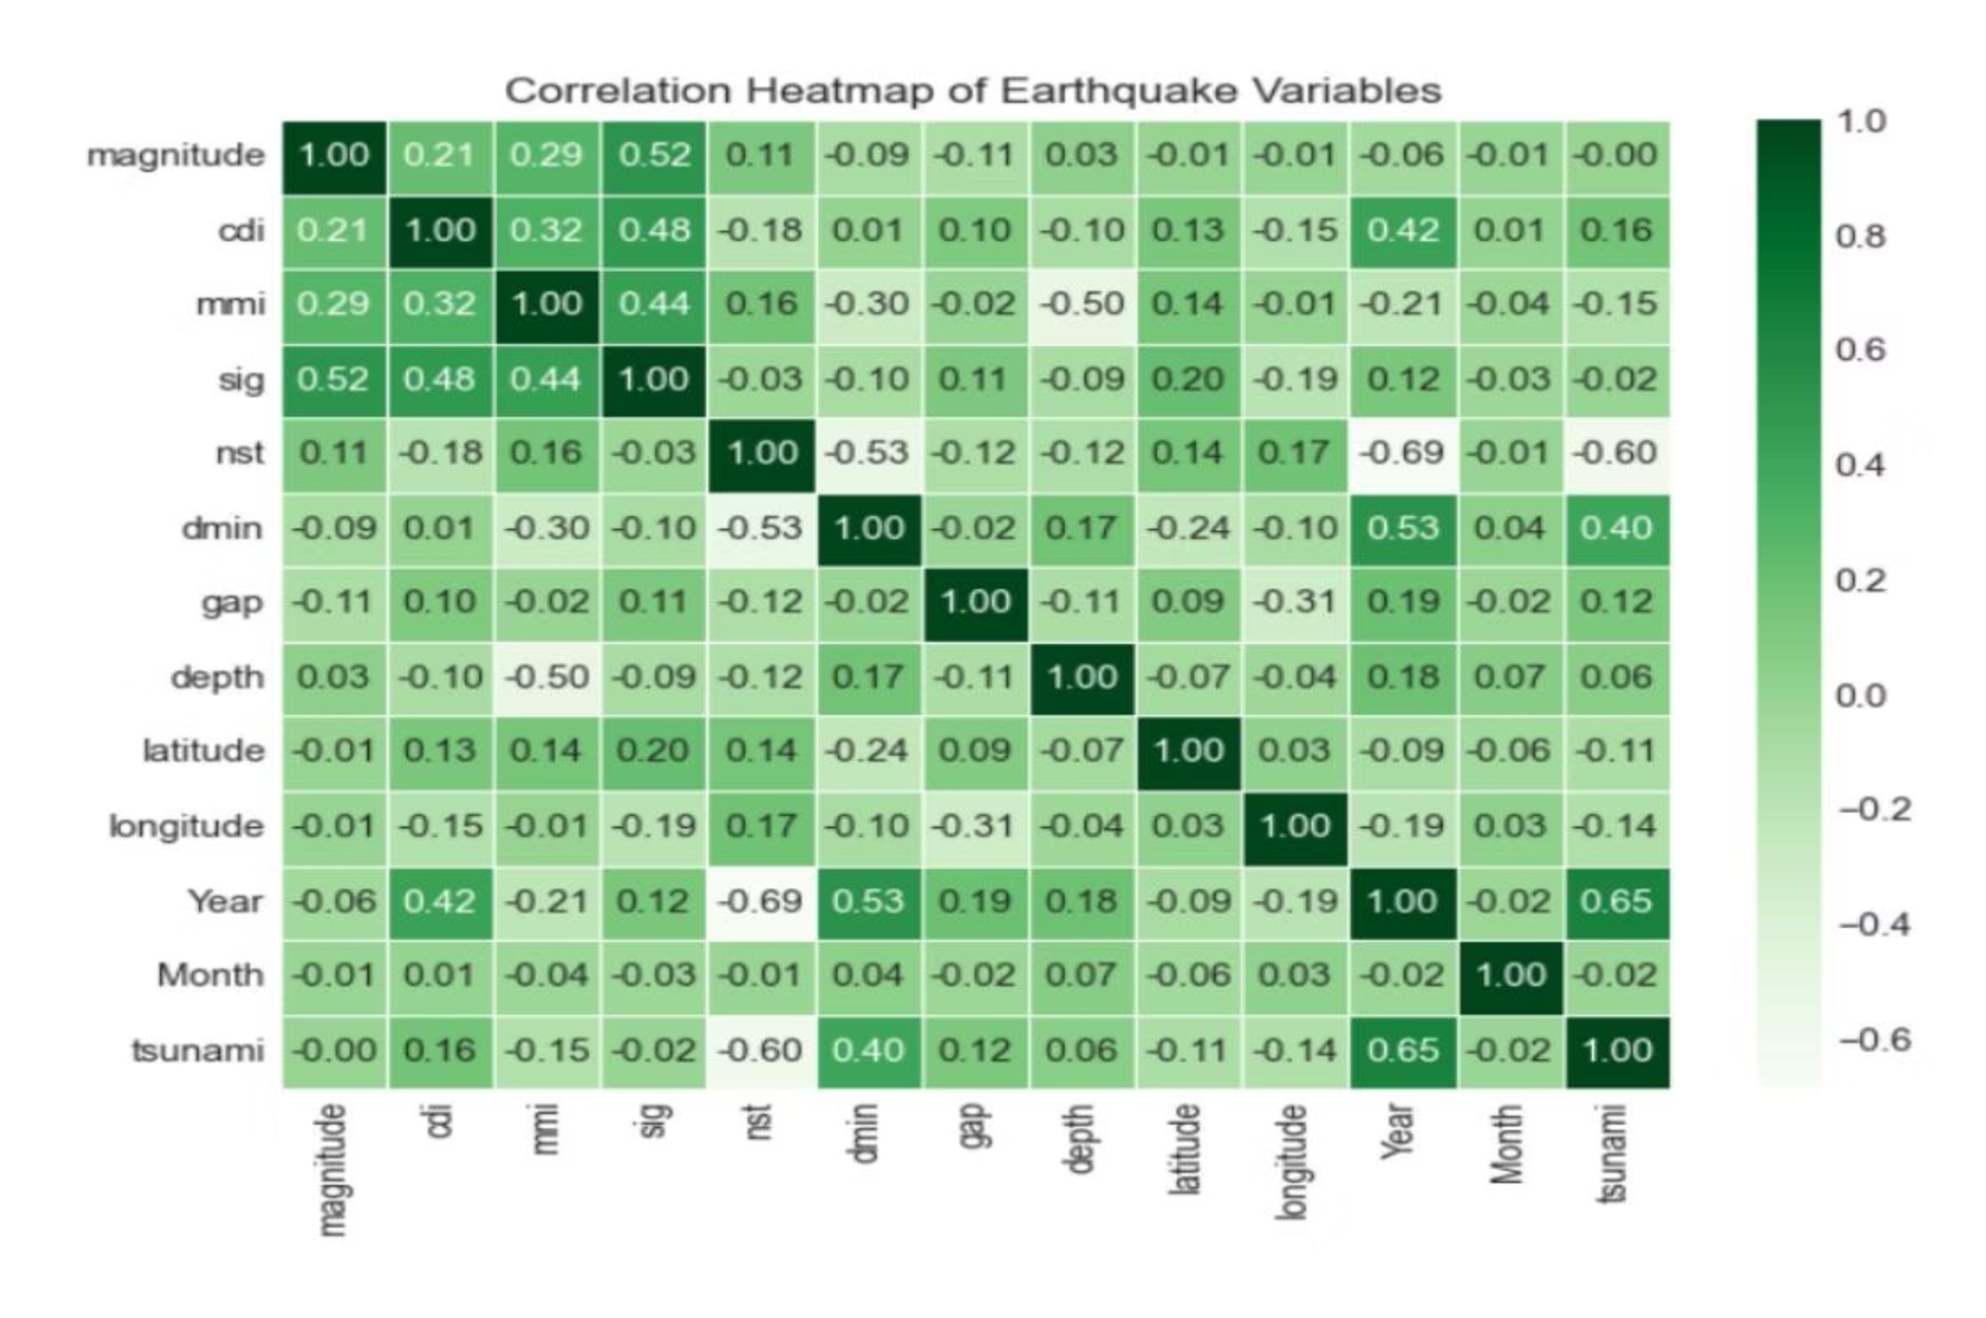


Conclusions and Future Applications
Seismic Parameters
Risk Assessment
Magnitude, depth, and geographical clustering play crucial roles in tsunami generation
Visual and statistical analyses provide strong foundation for identifying tsunami risks
Future Monitoring
Findings enable improved earthquake monitoring systems and early warning capabilities

